Slide 1
GME Stock Forecasting with NLP
Joey Xie

Slide 2
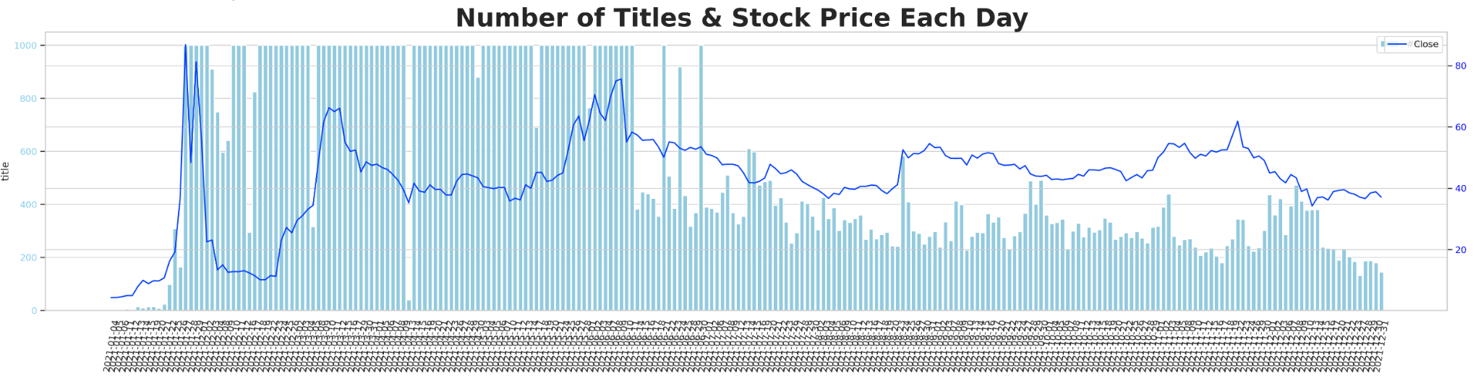
Background
In late January 2021, GameStop (GME) became the center of a financial phenomenon known as a 'short squeeze.' A surge of retail investors, coordinating through social media platforms like Reddit's r/wallstreetbets, began buying up GameStop's stock. This drove up the stock price dramatically. It gives us a great opportunity to study if we can utilize NLP techniques for analyzing Reddit post titles and to enhance stock prediction.

Slide 3
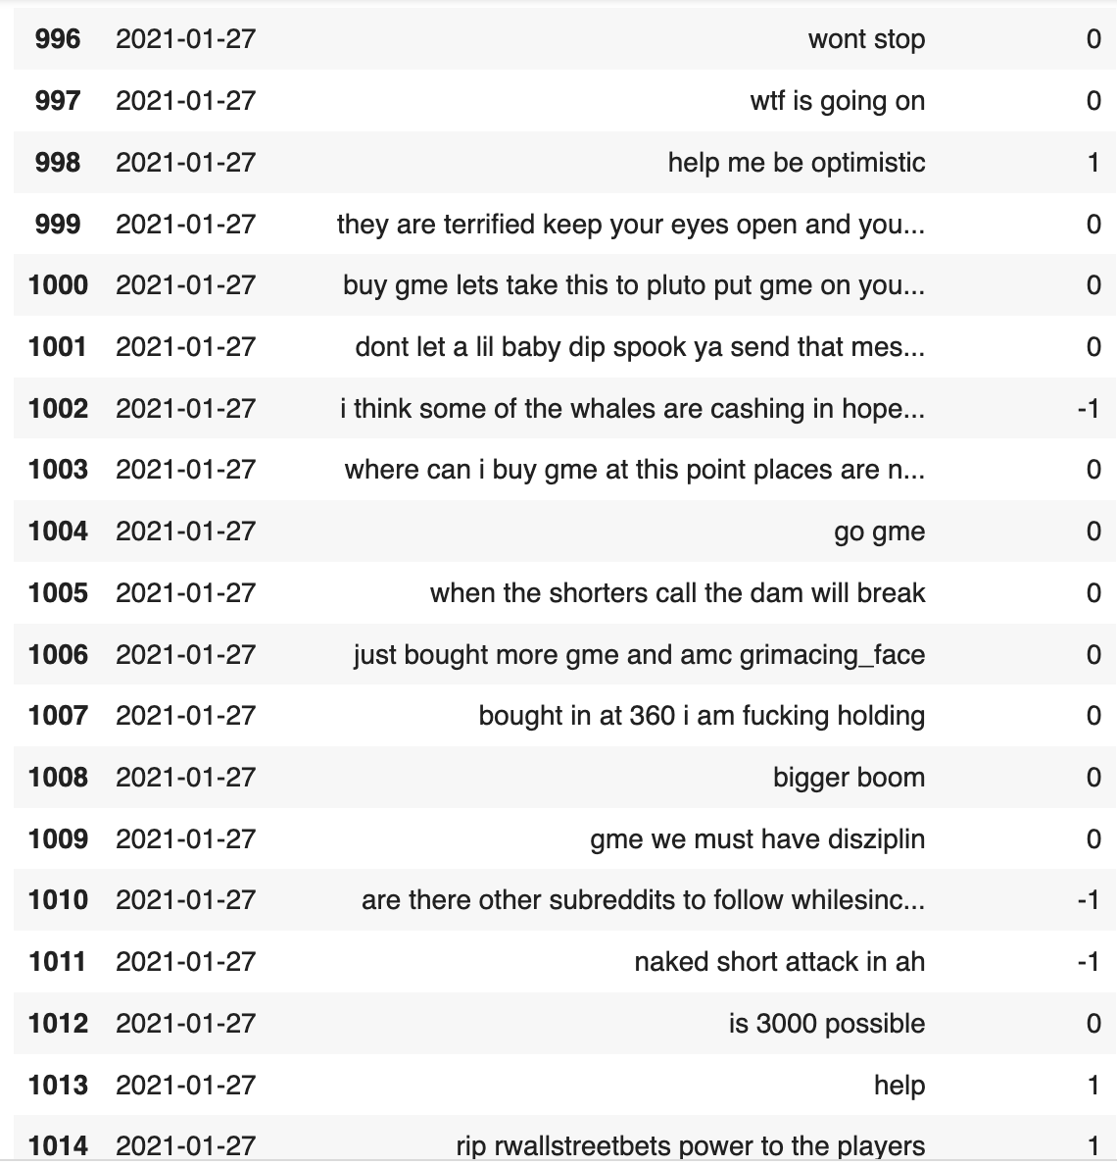
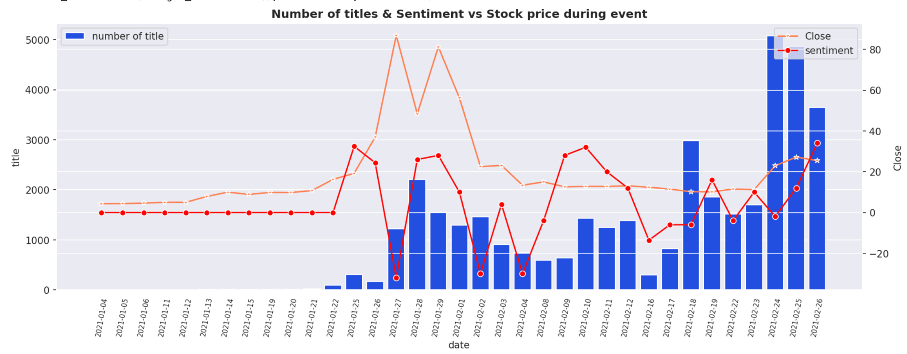
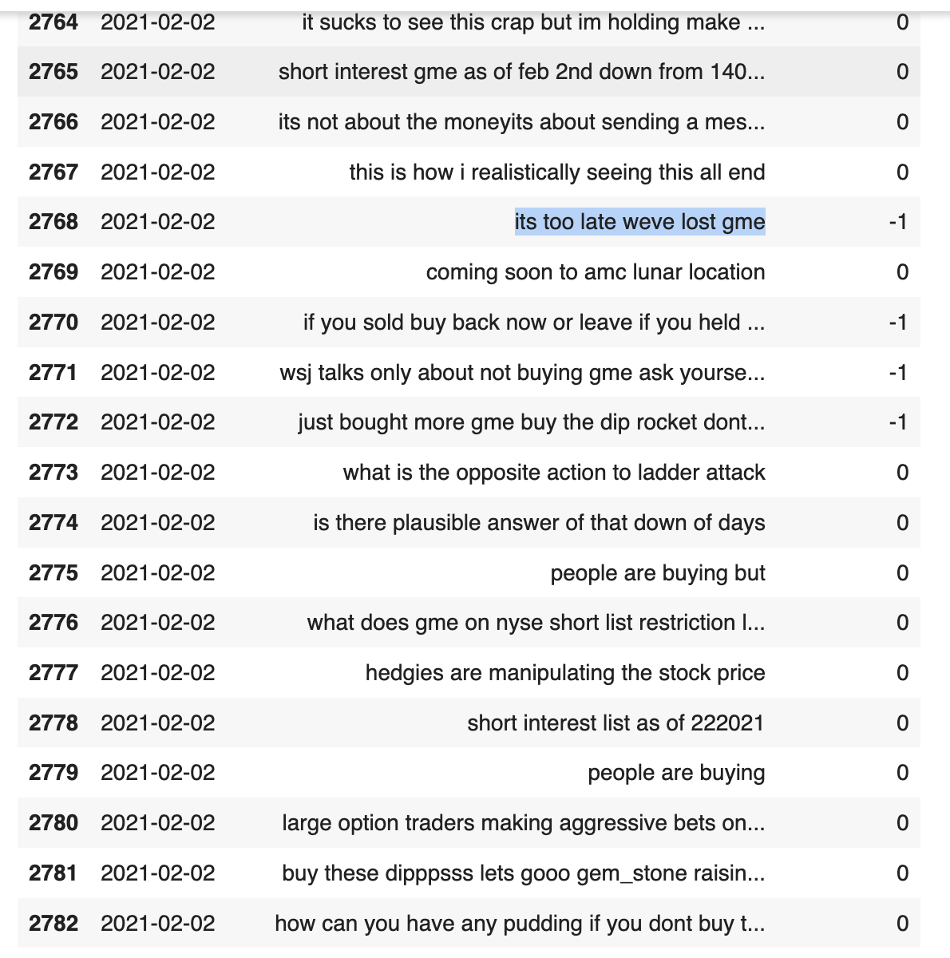
Event analysis
Jan-27
Around Jan-26, people gather on Reddit try to raise the price to beat wall street hedge fund. Therefore we can see a lot of posts urging people buy stocks, and celebrate. The stock price rise to 80 from <20 originally.
Around 20 Feb-02, seems like people are selling, because the war is over, or they cannot stand and hold it, we see a lot of posts that says they lost the war, urging people to keep up. But the stock price drop to <20.
Feb-02

Slide 4
Experiments
Fine Tune Bert-base with kaggle financial news dataset to get a language model that can be used in our NLP task
Experiment with three way to integrate NLP features:
Train LSTM with stock time series + sentiment labels
Train LSTM with stock time series + TF-IDF embeddings
Train LSTM with stock time series + Bert embeddings

Slide 5
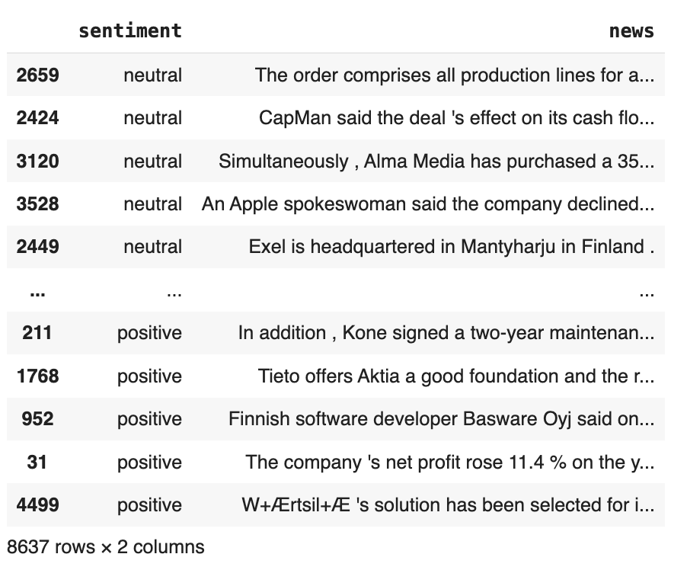
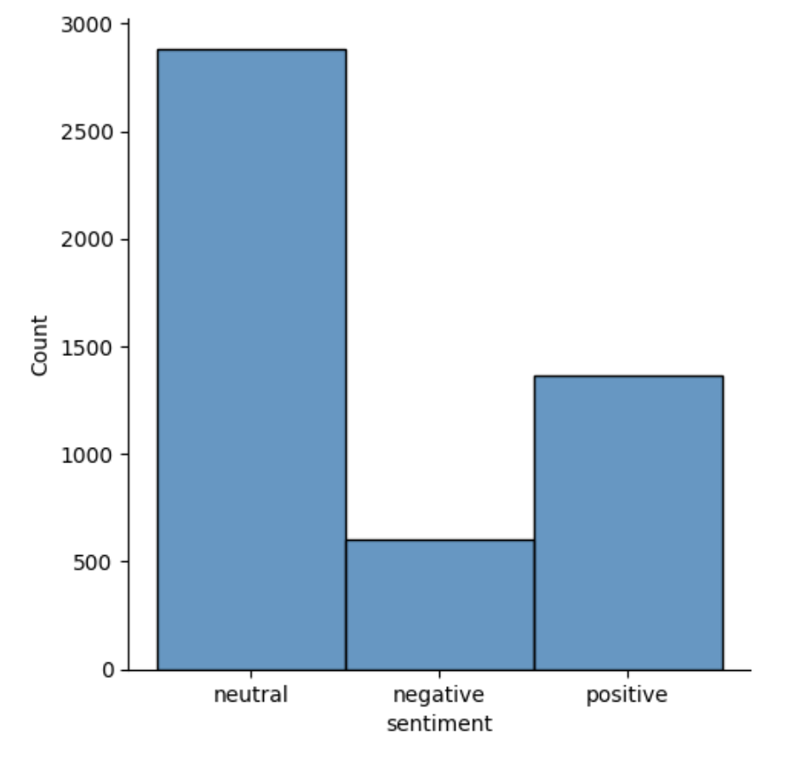
Fine tune Bert with Kaggle Financial news dataset
This dataset contains financial news titles and the sentiment label, which can be used to fine tune our base Bert model to better adapt to the financial domain for later use. Note that the classes neutral, negative, positive are highly imbalanced so we perform upsampling before training.

Slide 6
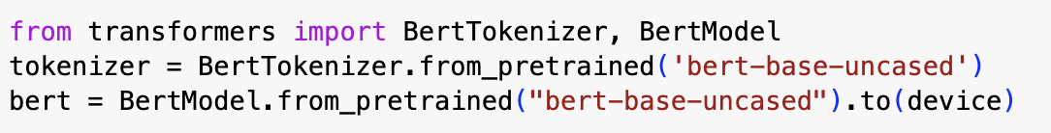
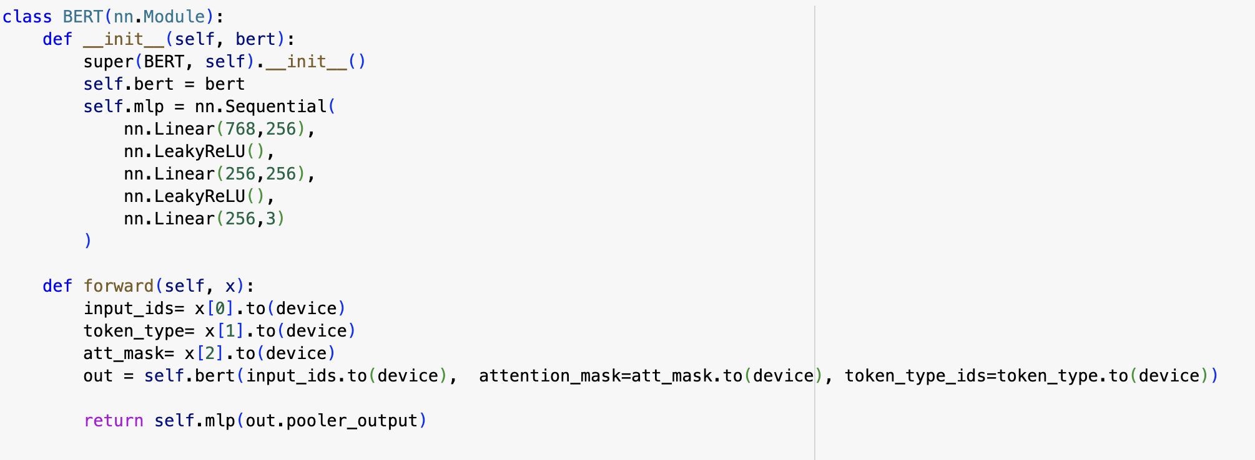
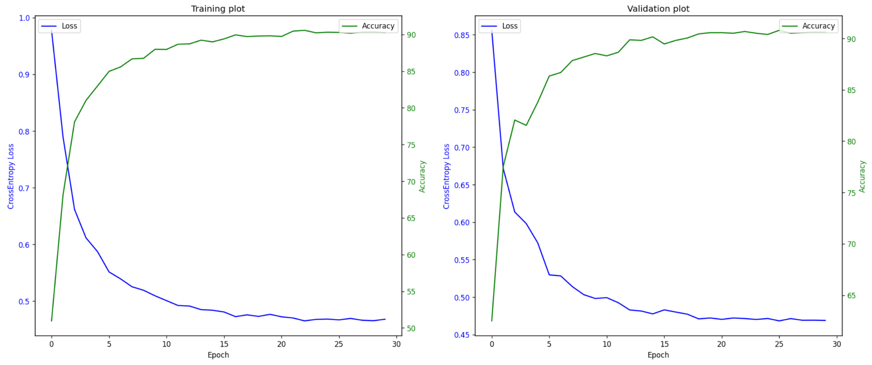
Model Training and Eval
We used the Bert base uncased model from hugging face, and add a MLP of sizes(768, 256, 3) to map the output to three classes, neutral, positive, and negative. The learning rate is set to 1e-5 for Bert and 1e-3 for MLP.
And from the curves we can see that the training and validation accuracy goes to 90%+.
Then we save the model to use it in the later time series forecasting tasks.

Slide 7
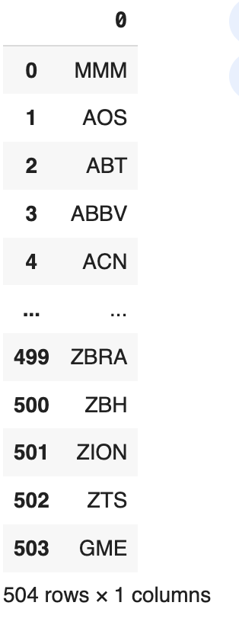
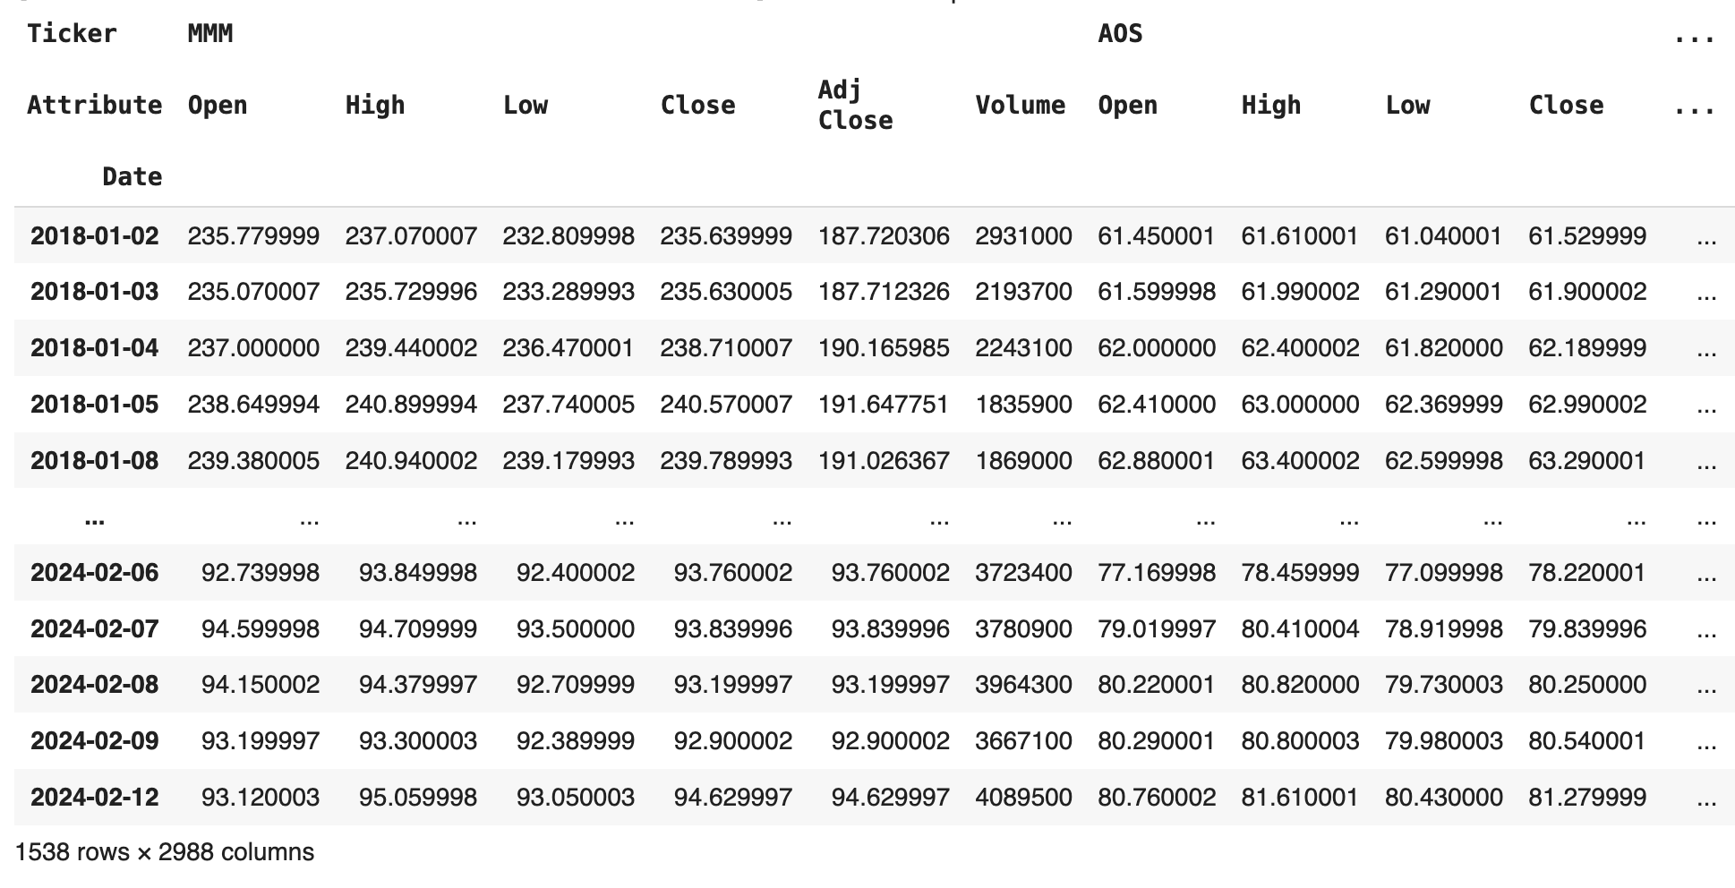
Scrape S&P 500 stock with yahoo finance
We scrape all stock information (Open, high, low, close, volume, adj close) of 504 stocks from 2018-01-01 to today, manually including GME(kicked out of S&P 500) to prepare for training.
Some of the stocks got bankrupted, so we delete them.
In our actual training process, we use only GME to train the model.

Slide 8
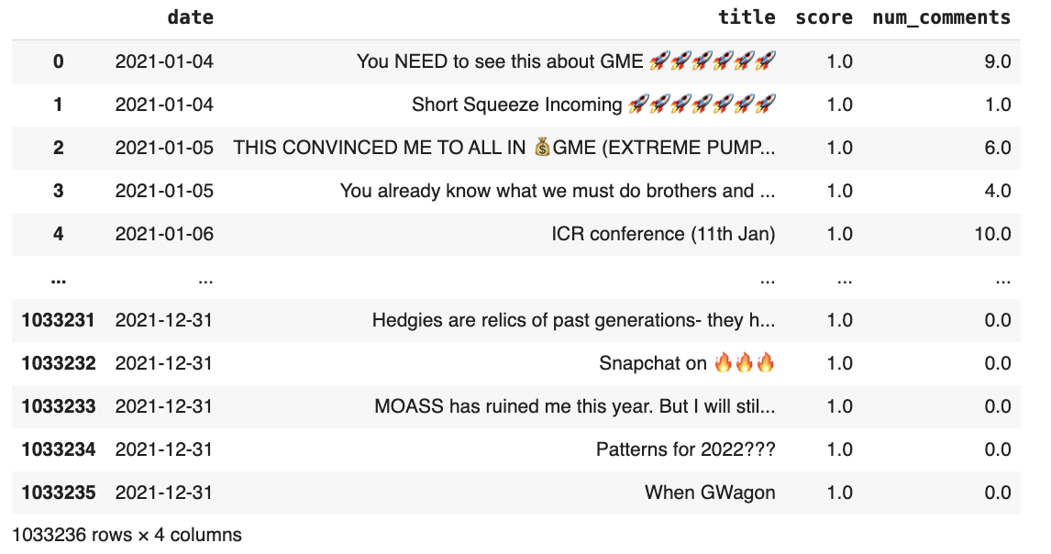
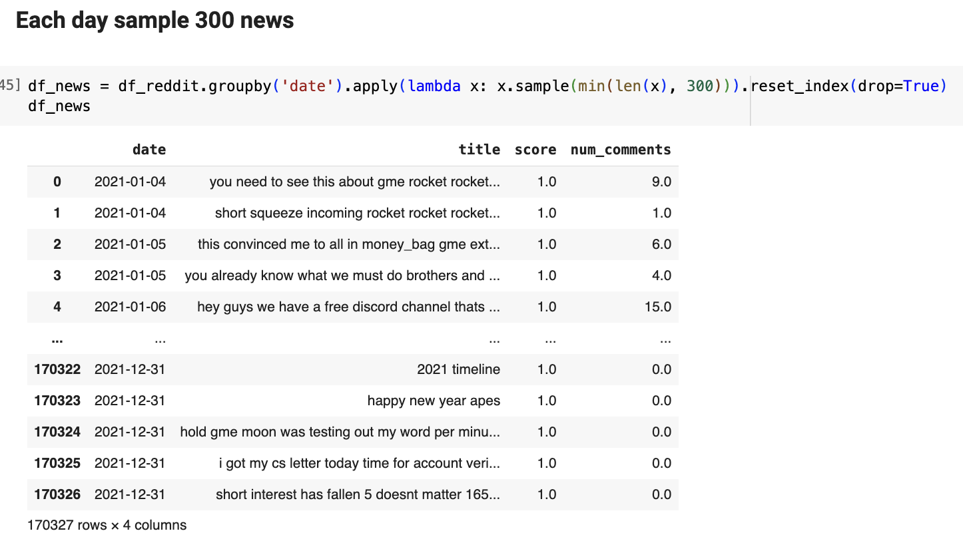
Reddit dataset preprocessing
The datasets contain Reddit post titles related to the stock GME of the whole year 2021.
We first demojize the emoji in titles to text. E.g. 🚀is converted into rocket, because it contains very important information about the stock. And clean the title by converting to lowercase and keep only words.
From the statistics, some days have number of titles >10k+, most of the days have around 300 titles. Therefore, we for each day sample 300 titles, which will be utilized later in NLP.
The we join the text information processed by various NLP techniques with actual stock time series in later part.

Slide 9
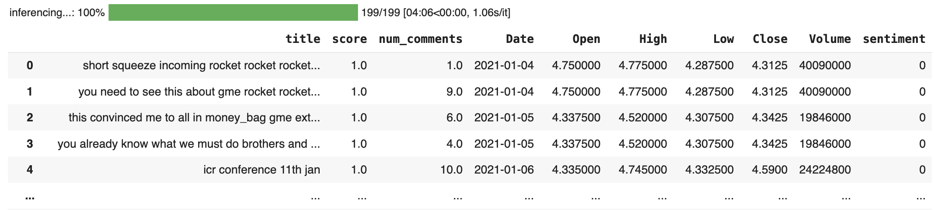
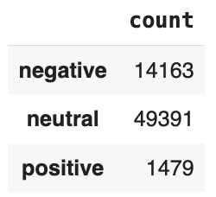
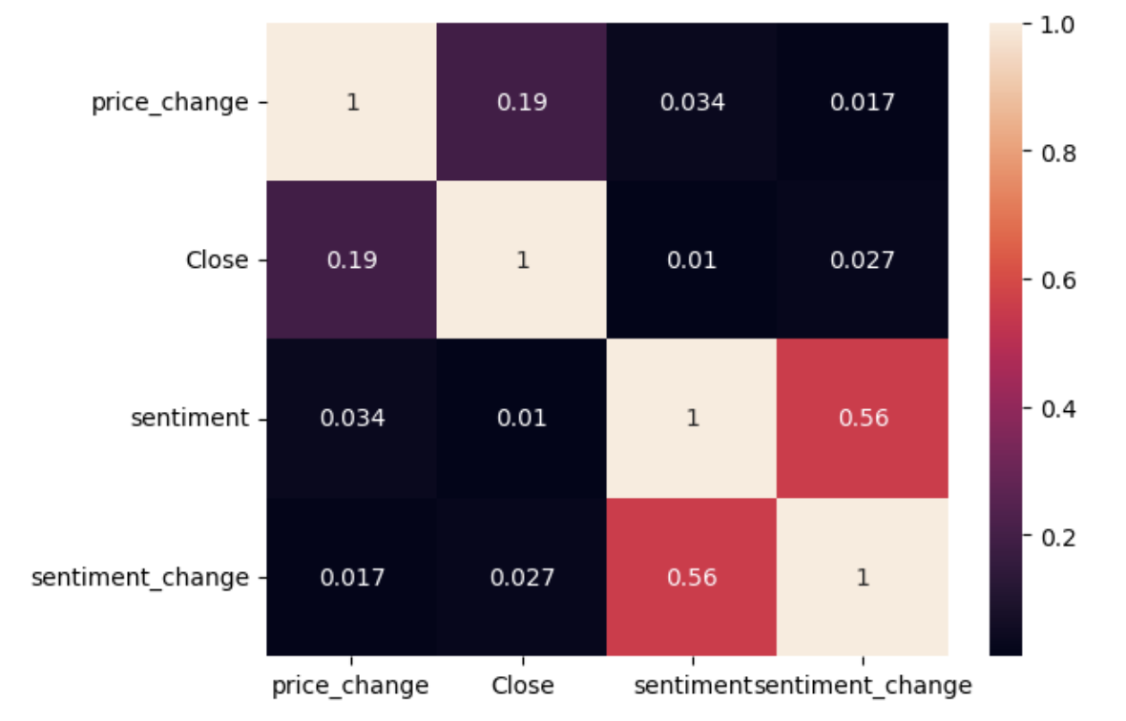
Time Series + Bert Sentiment Analysis(Baseline)
We used the Bert we fine tuned to output sentiment labels on each Reddit title. And take average sentiment score in each day.
However, from the heatmap, the sentiment analysis our fine-tuned Bert gives does not give a good correlation with price or price change. Therefore the sentiment is not going to be so useful. This can be due to several reasons:
1.Our Bert is fine tuned on kaggle financial news headlines, which is drastically different from our Reddit post, and the model fails to generalize to Reddit post.
2.Our model mostly outputs sentiment as neutral, if we could have included only positive and negative classes, or simply use the embeddings, it would give us stronger correlation with the stock price. Finbert I tried also output a large number of neutral, and cannot understand Reddit post without fine tuning.
But it serves as a good baseline methods, we'll train LSTM with sentiment labels first, and then explore Tf-idf embeddings, finally explore bert embeddings.

Slide 10
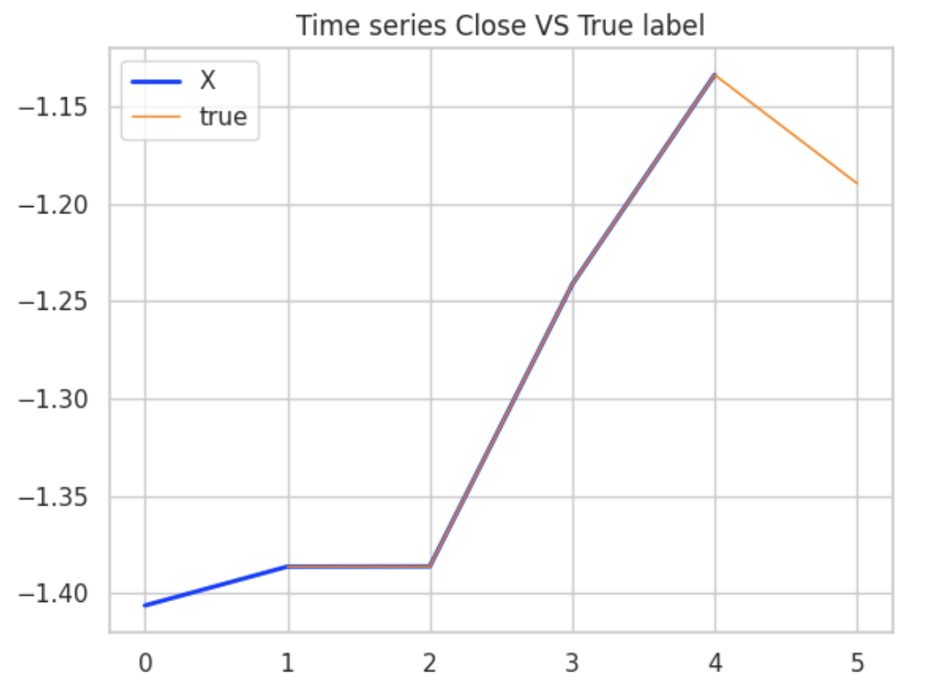
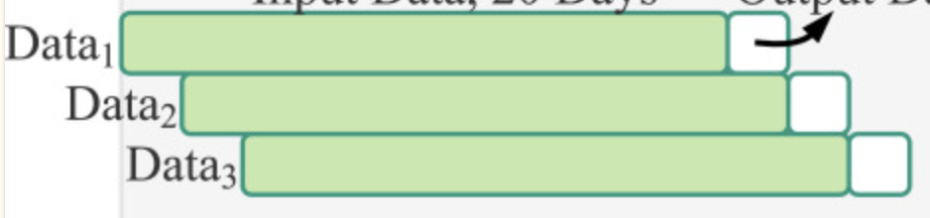
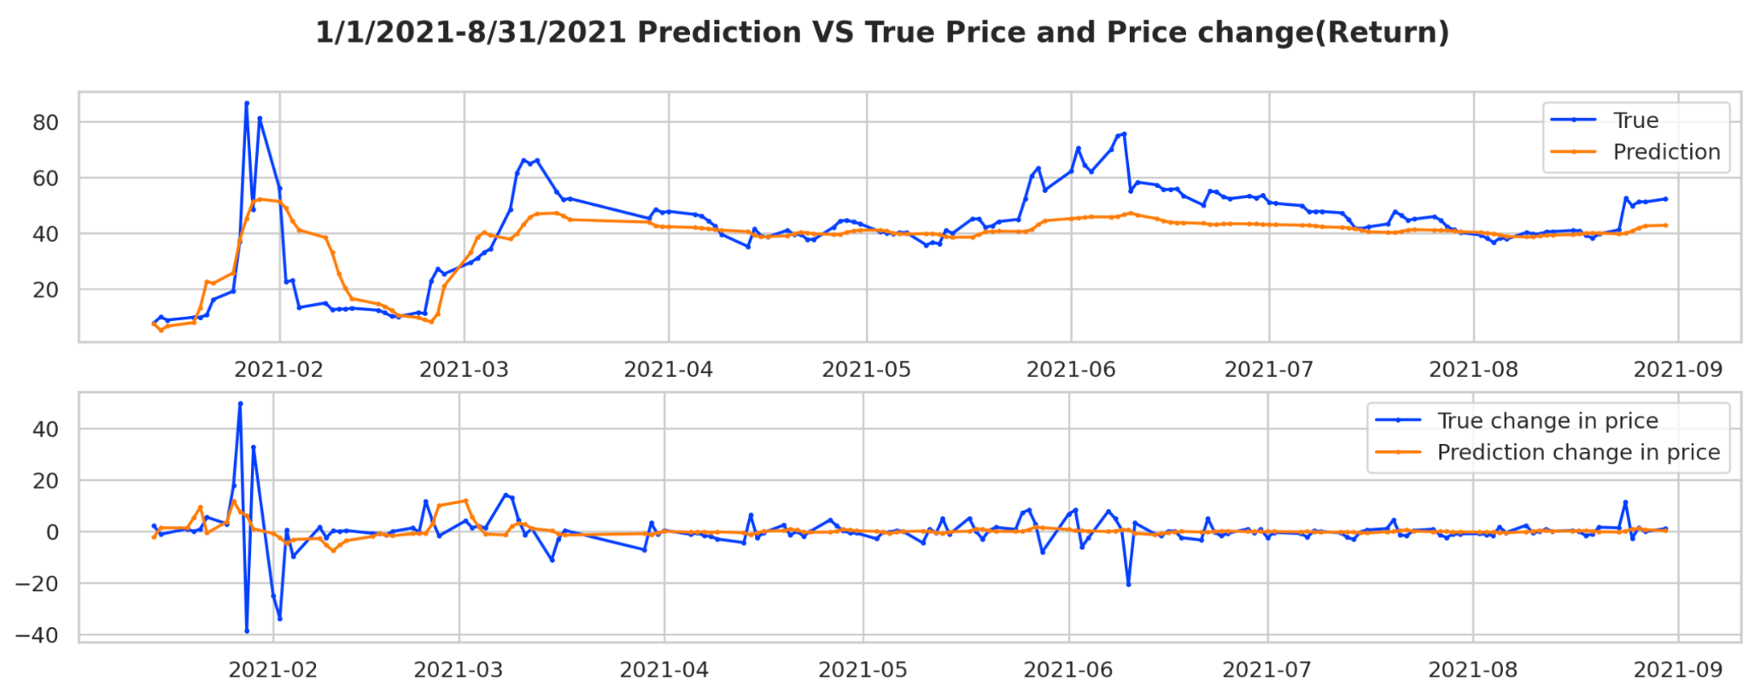
Time Series + Bert Sentiment Analysis(Baseline)
One data sample
Time Series data sample is constructed in sliding window manner. With last 5 days as a look back window and predict tomorrow’s price.
The feature dimension is 6 =5(open, high, low, close, volume)+1(average sentiment each day)
Train data: 2021-01 ~ 2021-05
Val data: 2021-05~2021-06
Test data: 2021-06~2021-09

Slide 11
Time Series + Bert Sentiment Analysis(Baseline)
From the prediction graph, we can see the model perform really bad, by predicting almost horizontal line and barely follow the trend. Probably because we have a significant amount of titles classified as neutral. If the sentiment does not provide much information, it’s very common for LSTM model with just 5 features to predict stock price with a horizontal line.
Although the Correlation Coefficient for the whole time series is high 0.87, we cannot trust that number! The deserialized Correlation Coefficient of change in stock price is negative, which means the model fail to predict the change in stock price, and even reversely predict the up and down. So we are going to explore the other two methods.

Slide 12
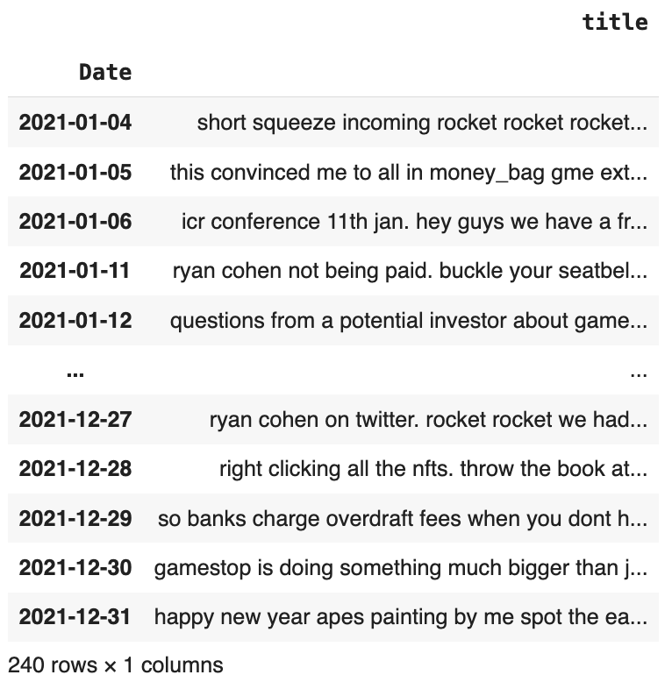
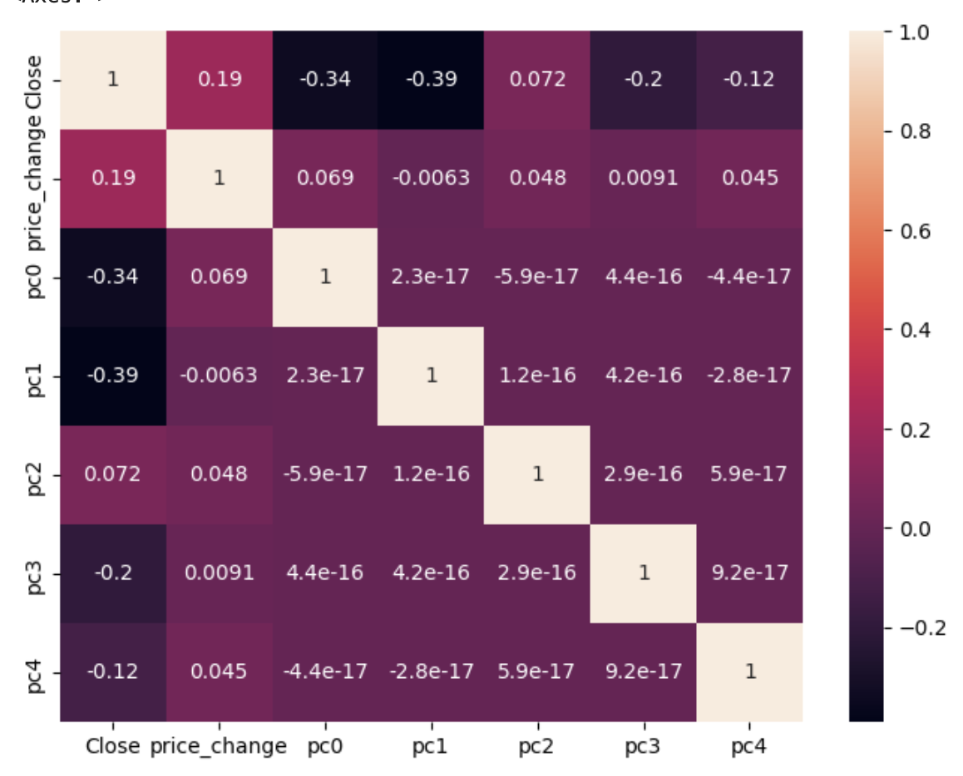
Time Series + TF-IDF embeddings
In this section, we construct the dataset by combining titles per day as one document, so that the entire dataset is a giant corpus, and each day has a document. The we use TFIDF Vectorizer to turn each day’s document into embeddings, and perform PCA to reduce 19k dimension vectors to 200 dimensions while keeping a explained variance ratio 91%+.
We can see from the heatmap that, the first few principal components correlate strongly, although negatively with the stock closing price, which indicates we can try to utilize them as predictors of the stock price.

Slide 13
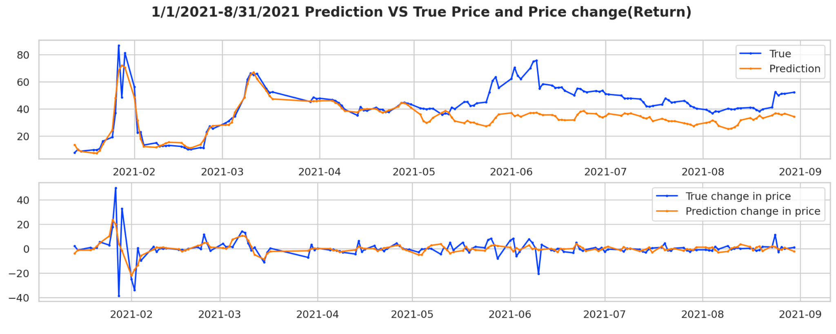
Time Series + TF-IDF embeddings
From the predictions plot, we can see that the predicted price is far off from the true price on the test data( 2021-06 to 2021-09), as we can see from the large RMSE. But the predicted change in price can more or less follow the true change in price, which is a big improvement than using solely sentiment labels. Also we can see this from the metrics that, the correlation coefficient of stock returns is 10% which is a decent IC number in quantitative trading.

Slide 14
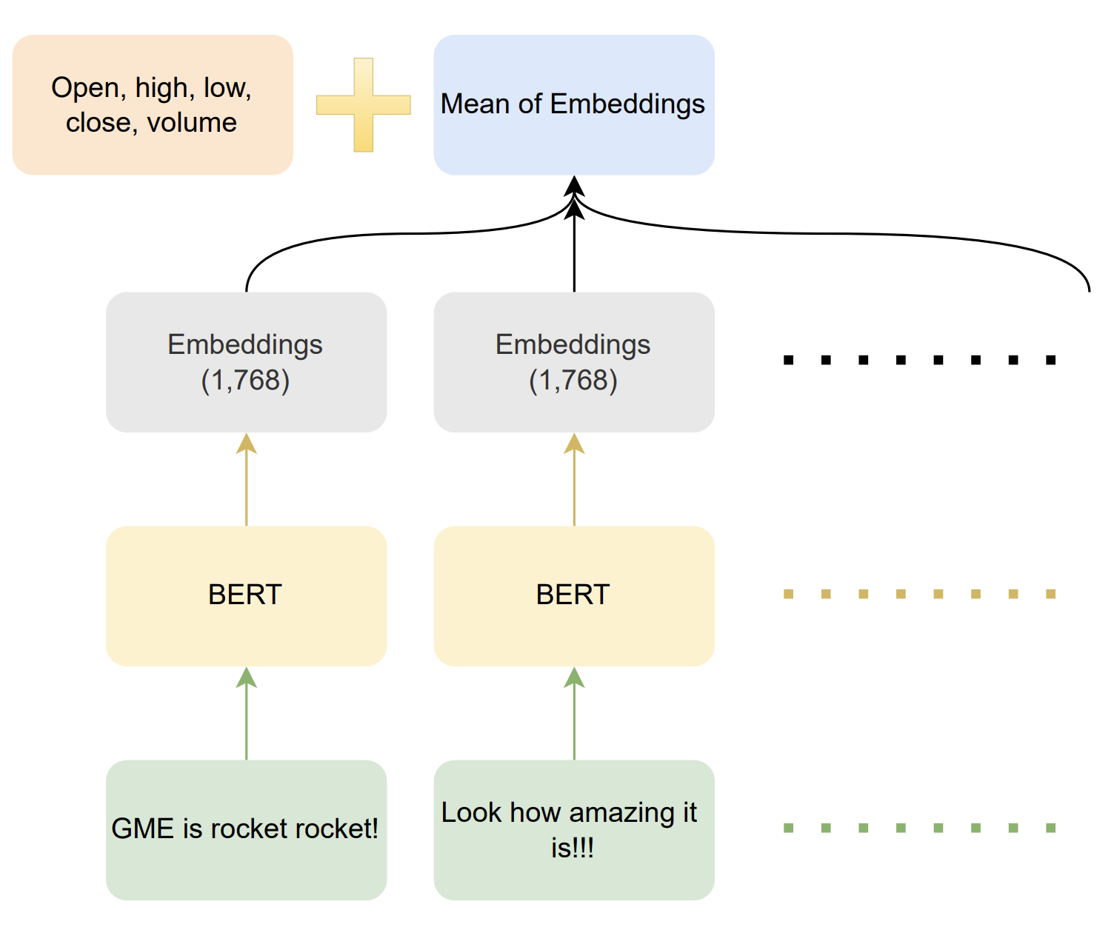
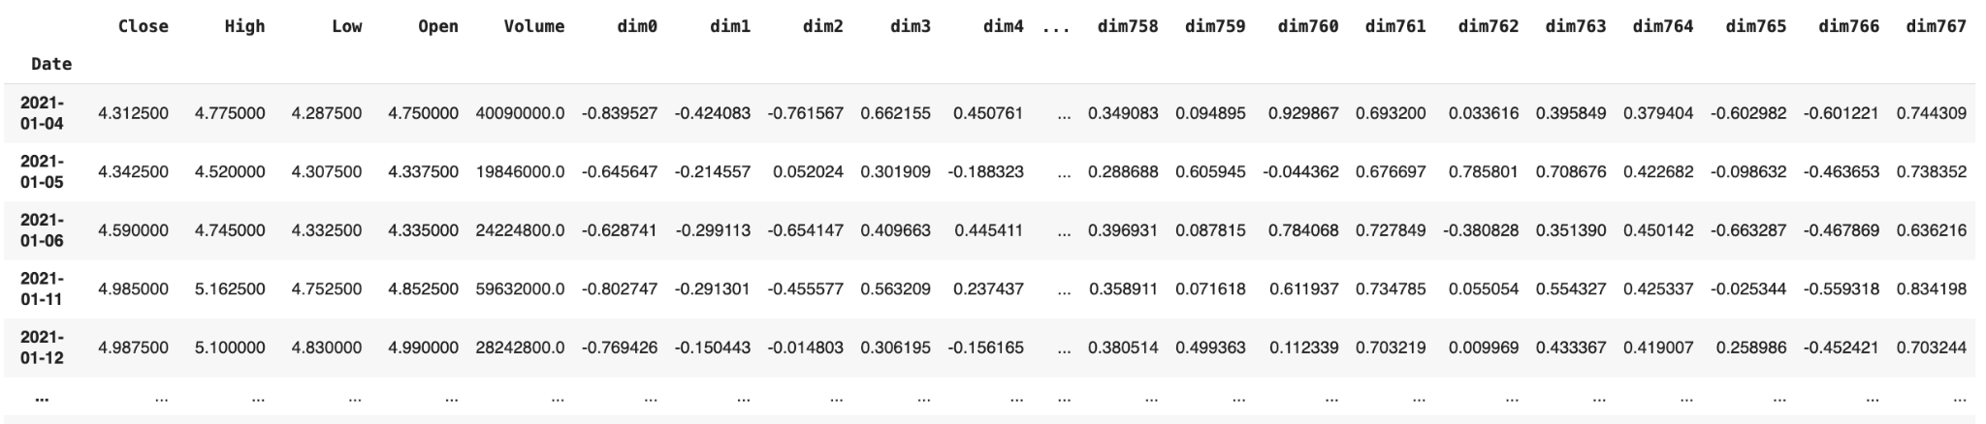
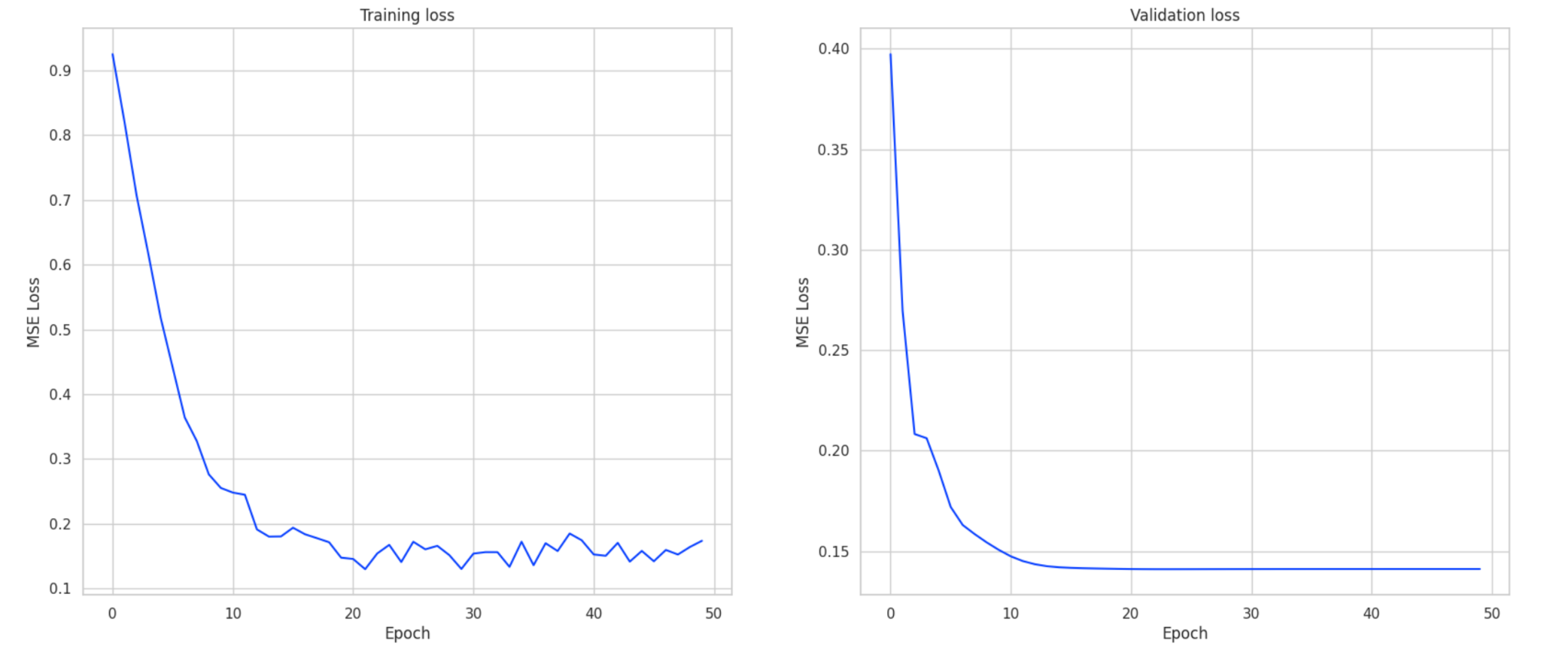
Time Series + Bert embeddings
Using our fine-tuned Bert, we can get the embeddings of each titles(pooler_output of [CLS] token), which is a summarization of information in each title of shape (1, 768).
Each day, we take the average of the 300 titles’ embeddings, and get a single 768 dimension vector, and we concatenate this vector with our time series each day, and get a 5+768=773 dimension time series.

Slide 15
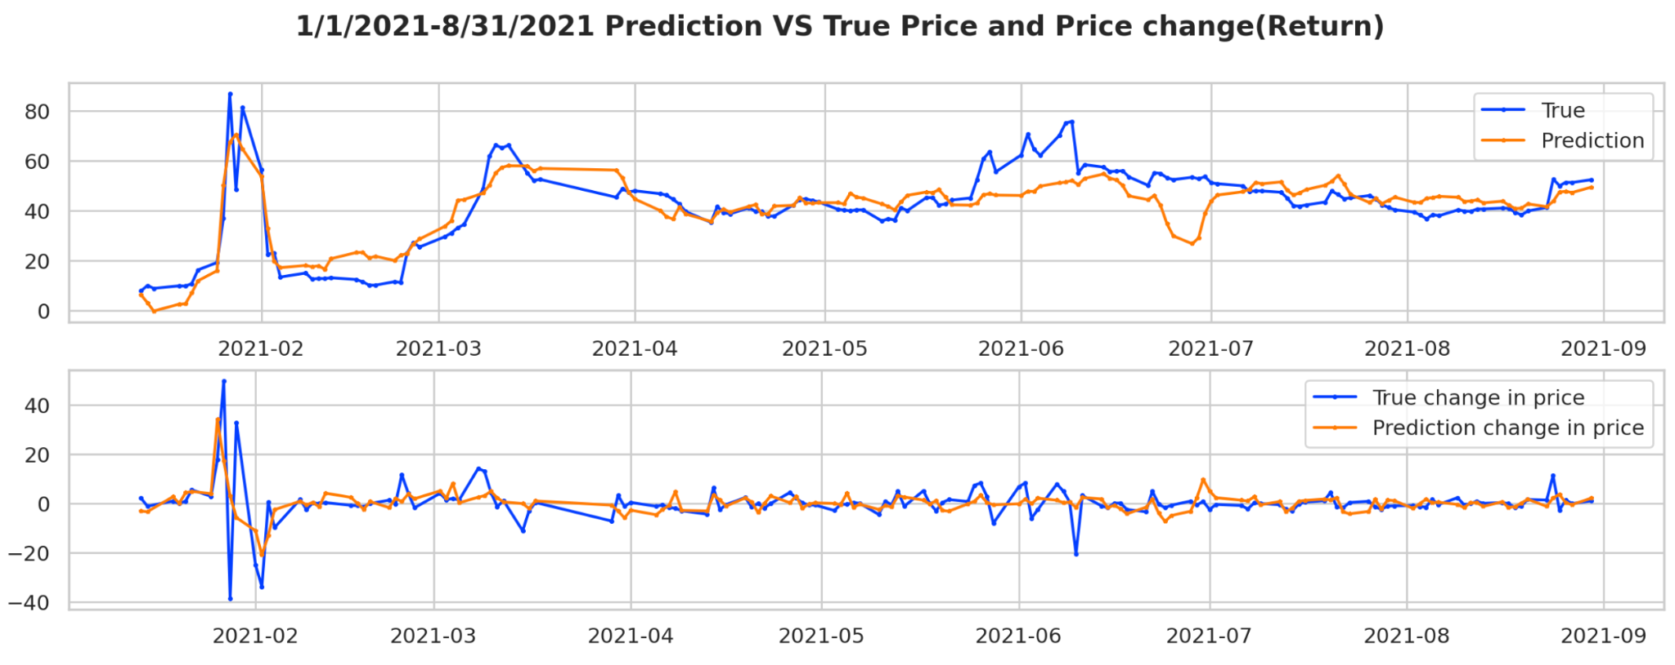
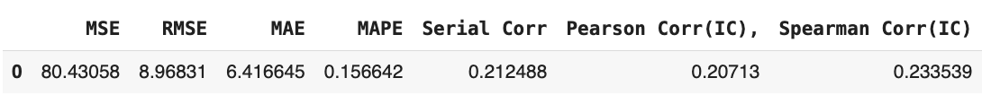
Time Series + Bert embeddings
We can see the model does a much better job at forecasting, and the Correlation Coefficient of our predicted change in price with the true price change reach 20%, which is very high in quantitative trading. Normally a multi-factor model of 1000+ technical indicators can get 18%+ correlation coefficient and make a million dollars. Our NLP model is performing very outstanding for this stock.

Slide 16
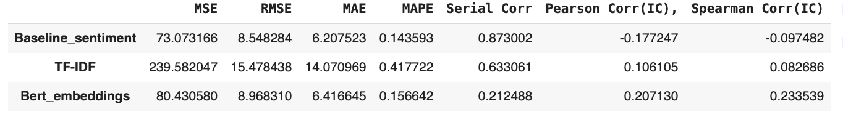
Summarization
As a summarization of model performance,
Our baseline model LSTM + sentiment labels although has the lowest RMSE, perform the worst job at predicting stock returns. Its prediction negatively correlates with the true change in price.
Our LSTM+TF-IDF model, perform a decent job predicting stock return, but the RMSE is really large, the stock price predicted is very off by scale.
Our LSTM+Bert embedding model, perform an outstanding job predicting stock price and return, and have a chance of creating solid profit for stocks that are affected by sentiment and news.

Slide 17
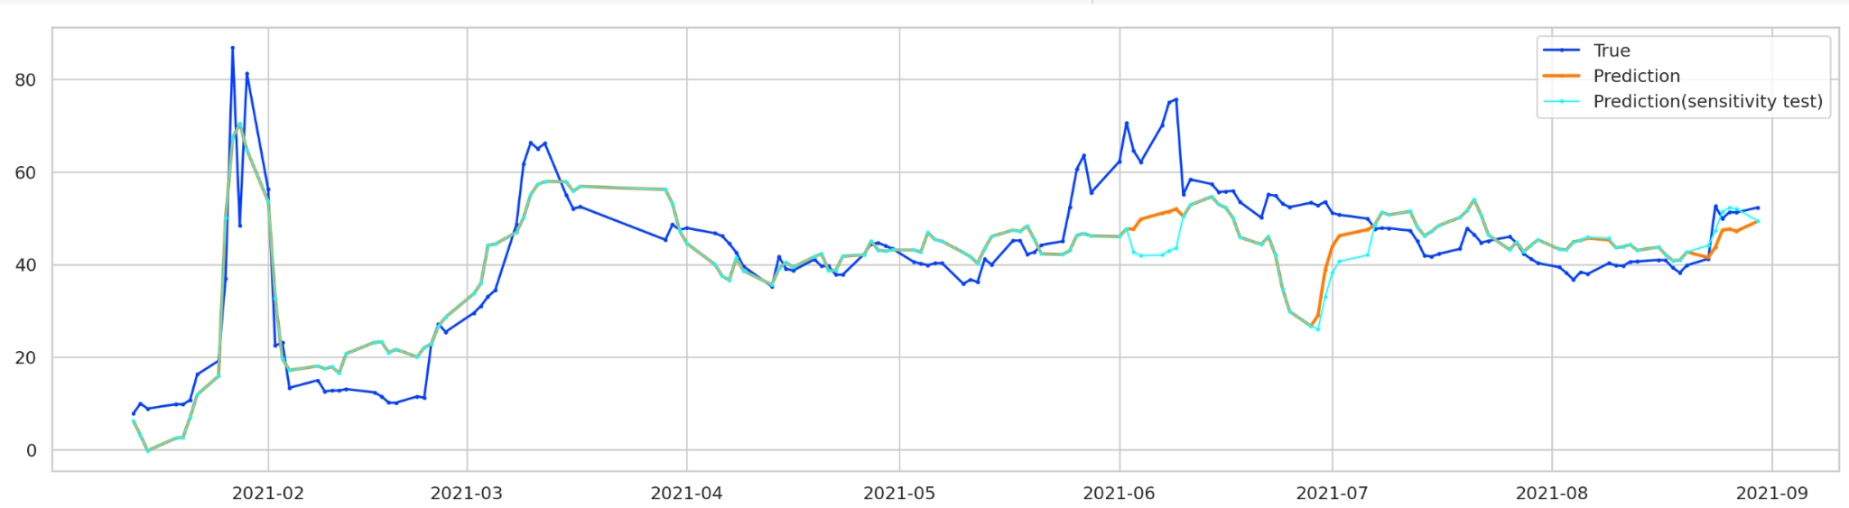
Sensitivity Test
Negative
Positive
Inject negative: I put bert embeddings of Feb-03( the day when the stock fall drastically) to Jun-02 and Jun 28. And we can see from the lightblue curve that the model now predict a lower price than before(orange curve)
Inject positive: I changed Aug-02 and Aug-20’s bert embeddings with Jun-07(the day when the stock stand on new peak) bert embeddings. And we can see from the lightblue curve that the model only slightly overpredict on Aug-02, and overpredict on Aug-20
These sentiment spikes could occur when a substantial number of people discuss and post in forums like Reddit or twitter. And we can detect them on time by regularly scraping online each hour or each day, monitor and notice if the number of posts suddenly rise related to the stock. And if they are very uniform and collaborative(like short squeeze), we are able to know the stock is going to rise or fall.

Slide 18
Algorithmic Adjustments
Our model is not uniformly or stably sensitive, and here are some strategies to improve it:
Fine tune our bert model using Reddit post dataset to better capture the language used there and generate better embeddings.
We can also fine tune bert together with LSTM when training time series prediction
Train with larger dataset for example, all S&P 500 stocks with corresponding news to better learn the relationship between reddit post and stock price
We can give most voted titles a higher weight in the dataset, because of their influence.

Slide 19
Summarization
Summarize: Our best performed model is LSTM+bert embeddings, with a outstanding correlation coefficient of change in price, but our sensitivity is not very uniform and stable.
Discuss: The study of GameStop short squeeze gives a very promising direction of including sentiment factors into traditional multi-factor forecasting model in quantitative trading to enhance the predictive power of traditional models. However, it's crucial to navigate the data collection process carefully to ensure compliance with copyright and privacy laws.
Propose: The future research can involve how to represent text better align with time series representations, probably using Large Language Model and multimodal techniques, contrastive learning to better differentiate between relevant and irrelevant information within textual data and noise in stock price. Such advancements could lead to more sophisticated models that better capture the nuanced relationship between market sentiment and stock price movements, offering a richer understanding of market dynamics and improving the predictive capabilities of quantitative trading models.
Some challenges involve filtering useful information from the whole web, not just reddit. Also in real-time trading, inference speed requires us to get useful news fast on time. We also underscore the importance of ethical considerations in data scraping activities, emphasizing the need to respect intellectual property rights and individual privacy.

